Slide 1
Spine Biopsy

Slide 2
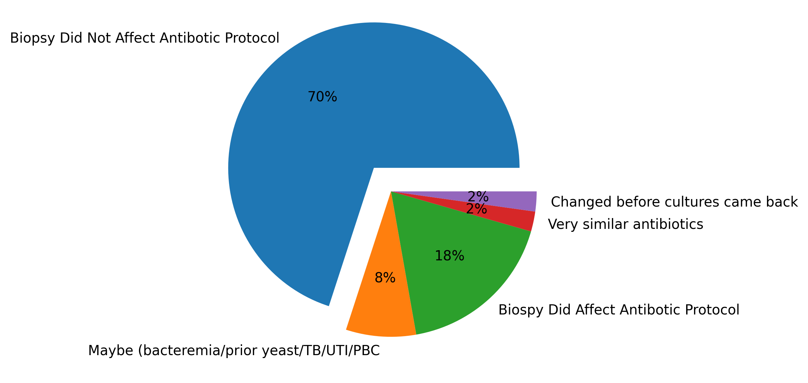
Did the biopsy affect the antibiotic course?
An astonishing 70% of the patients did not change their antibiotic protocol after their biopsy.
What other factors are playing a role in the efficacy of the biopsy?

Slide 3
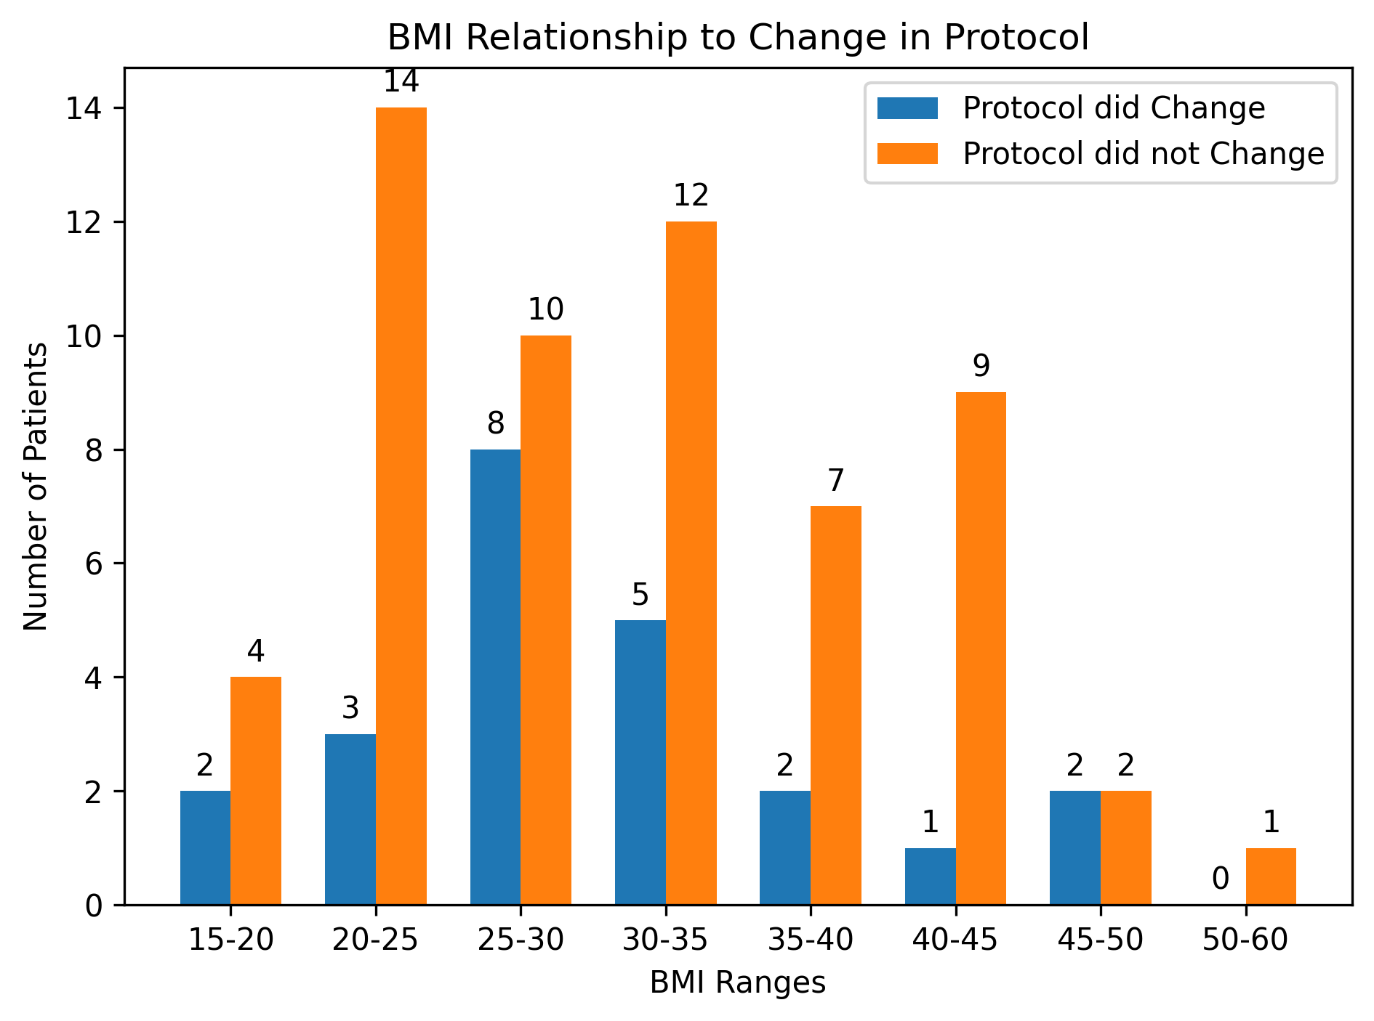
Does BMI affect whether the biopsy affected the antibiotic course?
Average BMI of those who had a change in protocol is 30.15.
Average BMI of those who did not have a change in protocol is 31.19.
L00ks like nawght

Slide 4
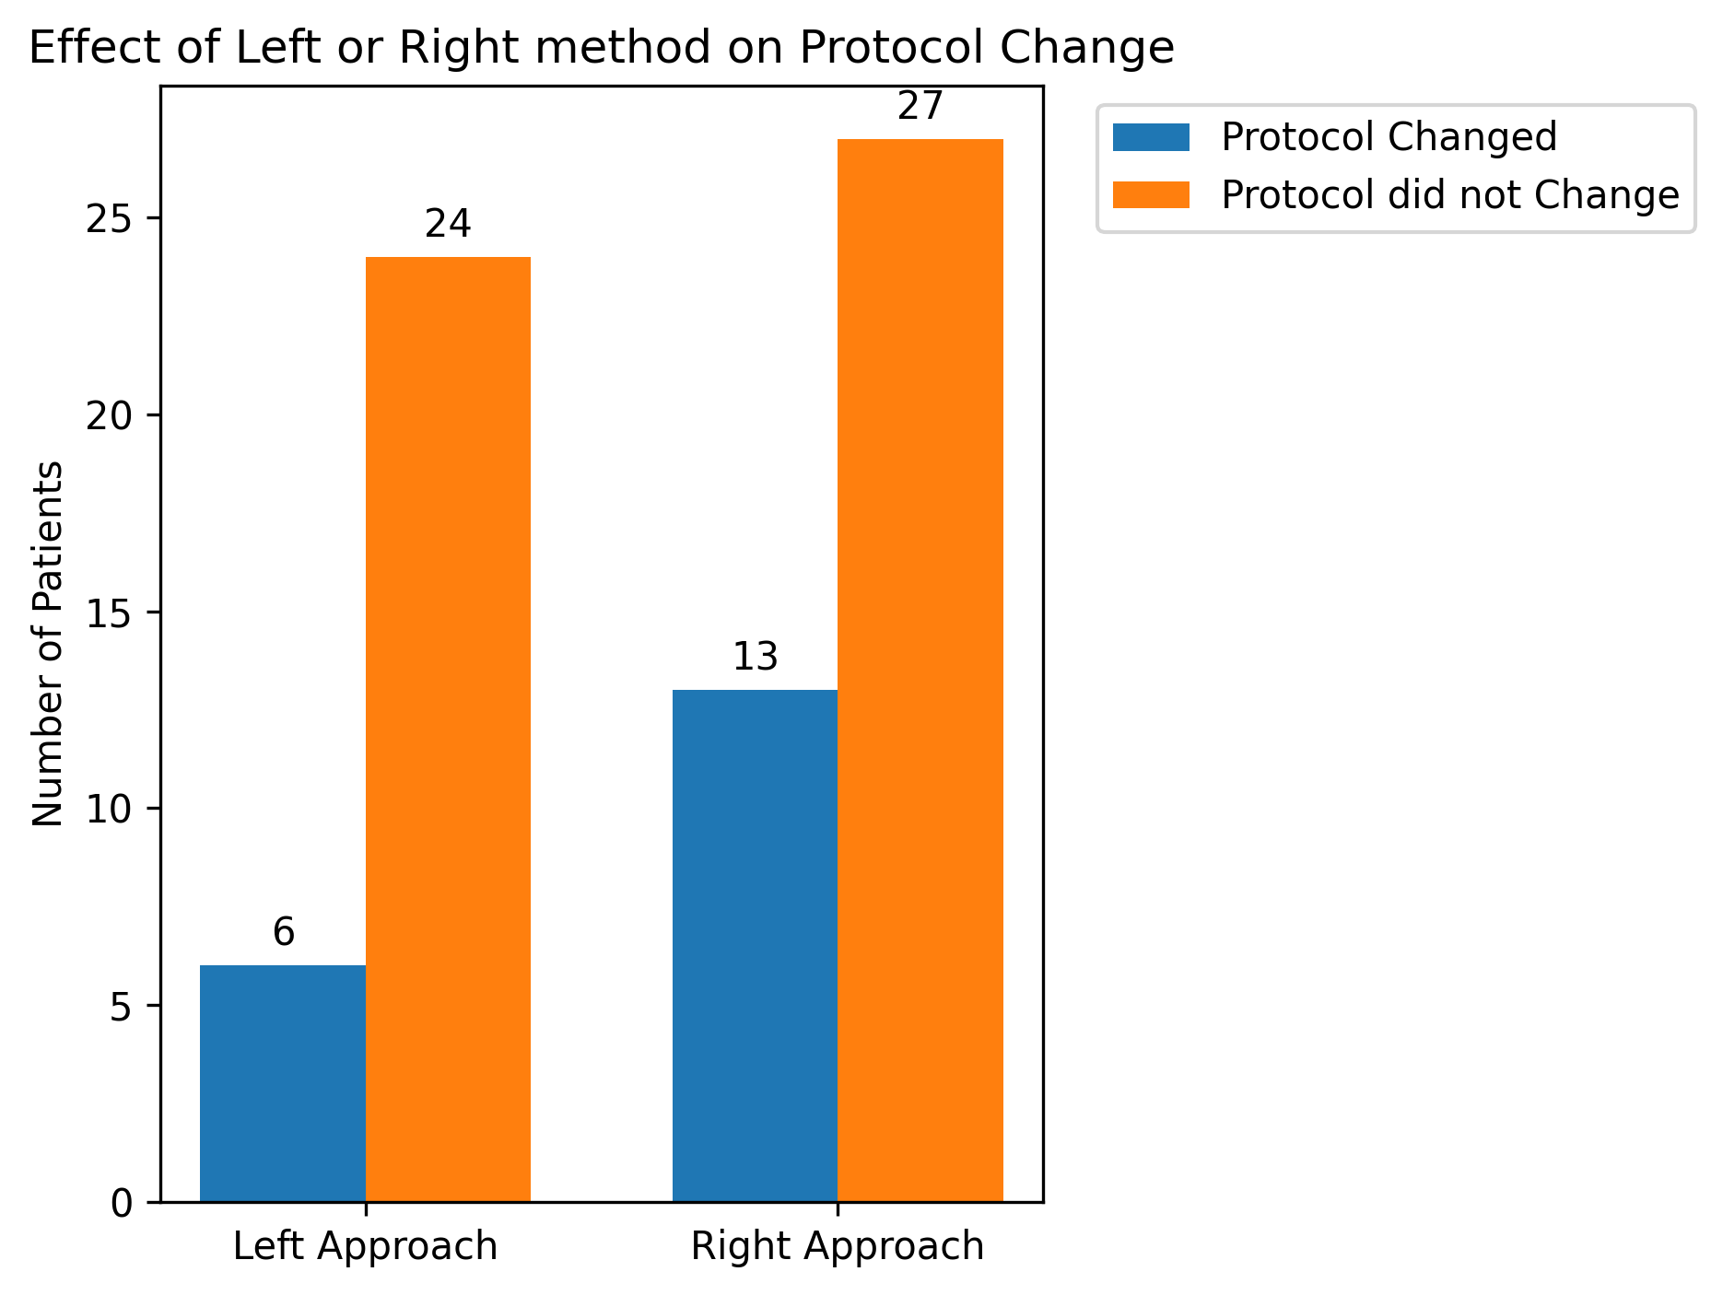
Does right or left approach affect whether the biopsy affected the antibiotic course?
Note: 2 patients from left approach and 2 patients from right approach were all placed on very similar antibiotics post biopsy procedure.

Slide 5
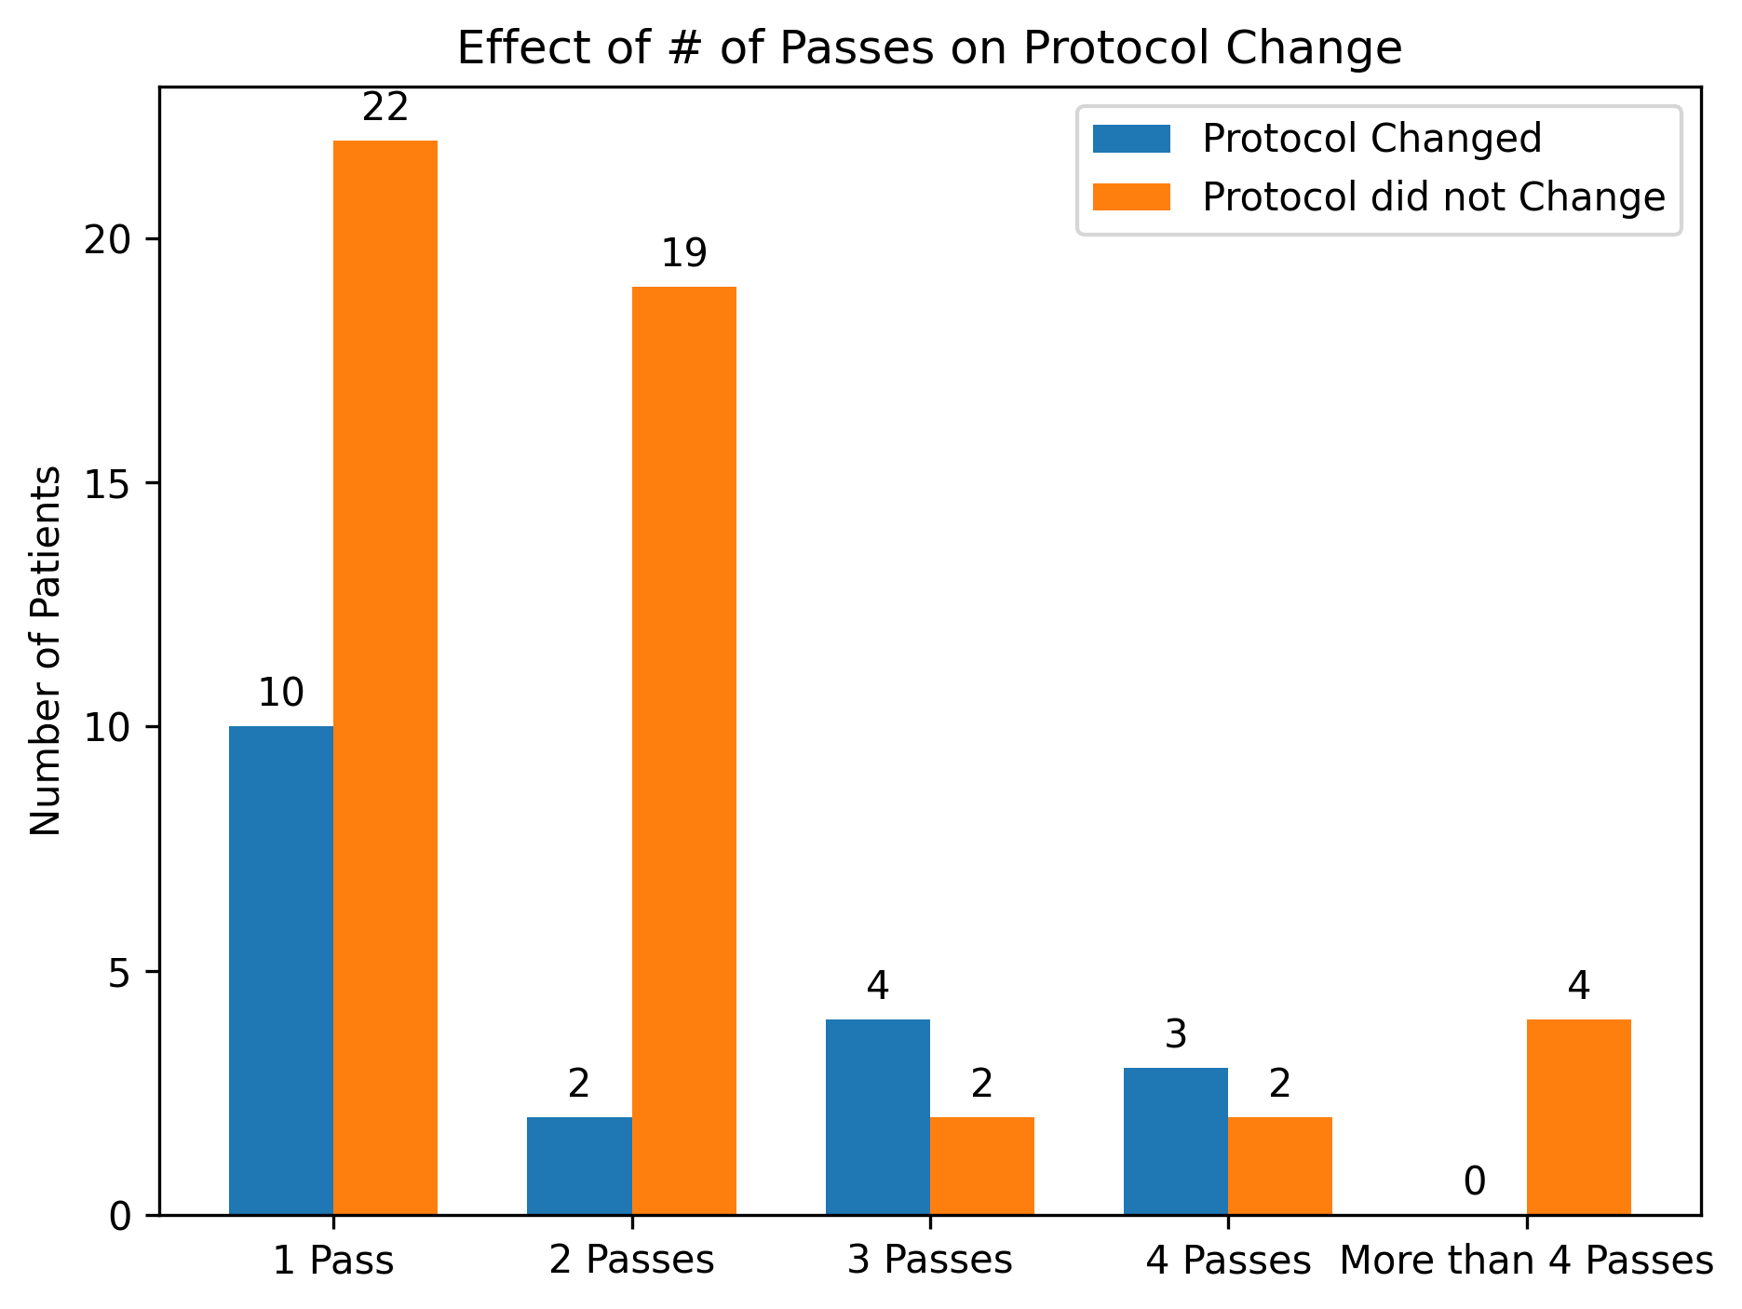
Does the number of passes affect whether the biopsy affected the antibiotic course?

